Slide 1

Genetic Algorithms for Optimizing Large-Scale Networks
EN.601.419/619 Cloud Computing
Spring 2020
Final Project Presentation
April 29, 2020

Slide 2



Team Members
Vaikunth Dharwadkar
Ankur Kejriwal
Pranav Shirke

Slide 3
AGENDA
Problem Statement
Recap: Genetic Algorithm
Our Approach
Experiments
Results
Our Progress
Future Work

Slide 4
Problem Statement

Slide 5
In today’s day, we have very large networks. While it is not feasible to perform changes to the network while having a global view, an approach like the jellyfish network might completely be random and could subsequently lead to bad configurations. Thus, we are proposing a pseudorandom way to approach this problem using genetic algorithms. This gives us the benefit of both speed and an optimal solution.

Slide 6
Motivations for using GAs
Generality
Optimizing for Multiple Parameters
The Building Block Hypothesis (BBH)
Parallel Nature and Scalability
Easy Implementation

Slide 7
Basic steps in a genetic algorithm
Initializing genes randomly
Calculating fitness function
Performing crossover
Performing mutation
Performing repair (optional)
This process is repeated till there is convergence

Slide 8
Initialization
We are adding the node randomly to any other node with just one new edge in default setting.
This is done n number of times were n is the size of the population
The code can be edited to add multiple edges or even multiple nodes!
An added option is to mutate all/some of these configurations to introduce networks that are different

Slide 9
Fitness Function
The fitness function has the options of max-degree, network cost, min-cut edge, min-cut node, total flow size and time delay in sending packets
You can even add more if you want! An example would be the average degree of a node if you are allowed to add/remove edges
We normalize these values to give each an equal importance to all the features, but these can be tweaked according to users’ priorities
Each parameter takes a different amount of time to calculate so you can customize according to your needs!

Slide 10
Crossover
We select the parents using roulette wheel strategy without replacement .
We perform crossover by randomly selecting ‘x’ number of edges from Parent 1 and the remaining edges from Parent 2
Ensuring that the overall topology is maintained and number of edges remains constant
For Child 2 we do the same procedure but give Parent 2 the first preference this time for selection
Thus , ensuring equally weighted characteristics of both the parents are propagated in the children .

Slide 11
Mutation
We perform mutation by randomly selecting 2 nodes and then again randomly choosing multiple edges belonging to these nodes and switch them
We can do this for an arbitrary number of nodes too
This allows us to see unseen configurations we might have missed in the past
We have provided an option of timeout where you can stop mutation if it exceeds a certain time limit

Slide 12
Repair
We are repairing illegal configurations in 2 ways
The first option allows you to mutate the tree recursively till you get a valid configuration
In the 2nd one, we simply drop the illegal trees
We then select the n best genes we have where n is the size of the population. (buzzword is elitist strategy)
P.S. Almost all the computations mentioned can be done in parallel!

Slide 13
Experiments
Ran one of the experiments on the Autonomous systems’ (AS) data
Data collected from the University of Oregon Route Views Project
733 daily instances
The dataset exhibited both the addition and deletion of the nodes and edges over time

Slide 14
Experiments (cont.)
Dataset Statistics
Nodes | 6474
Edges | 13895

Slide 15
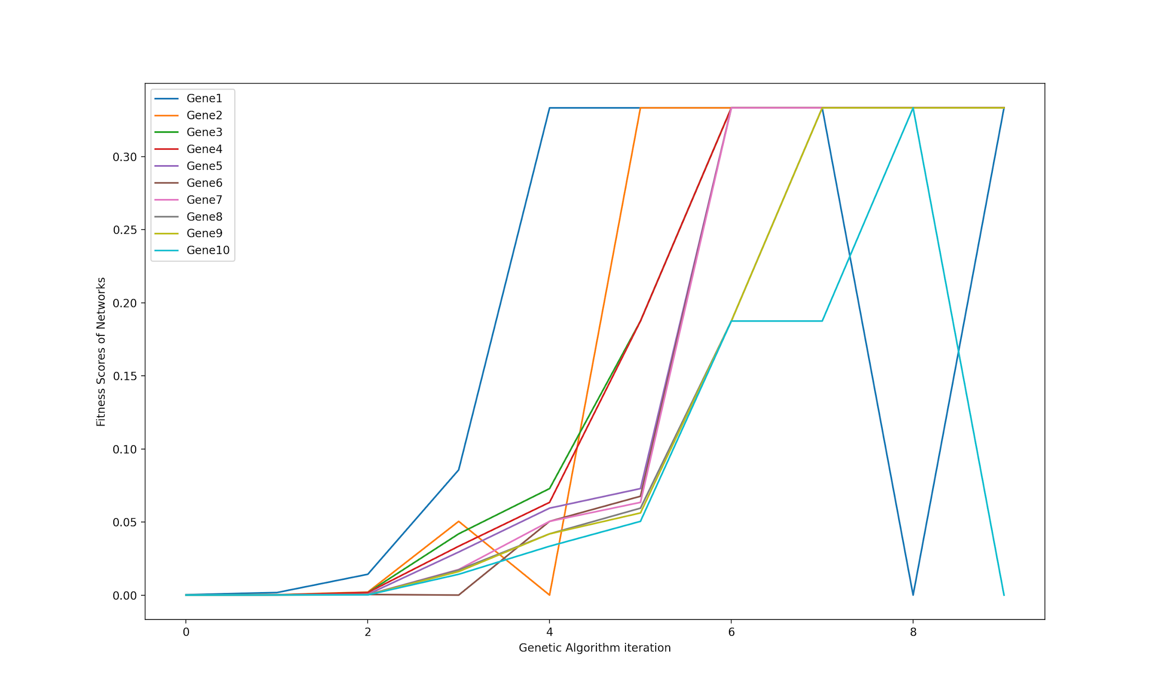
Results # 1
Fitness Function parameters:
Max Degree
Network Cost
(Weight)

Slide 16
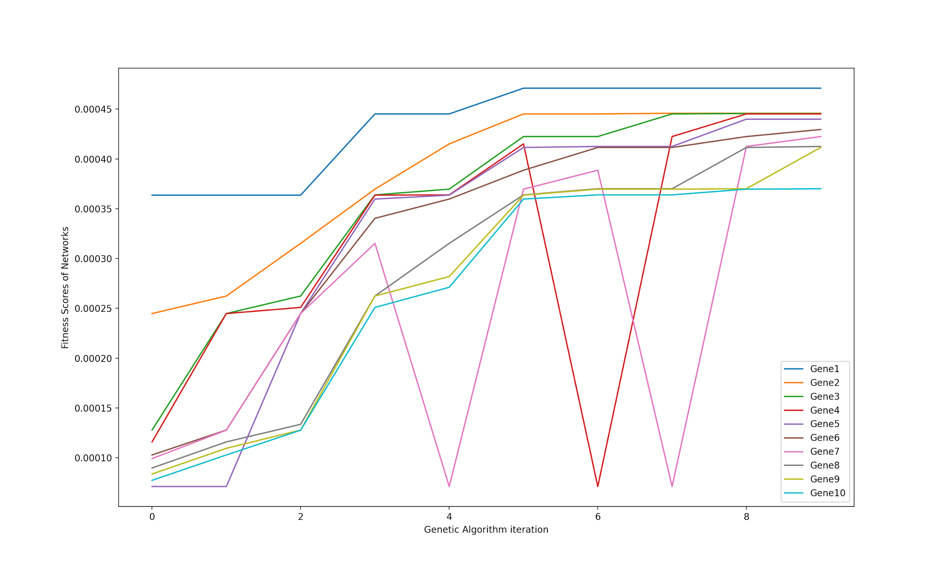
Results # 2
Fitness Function parameters:
Max Degree
Cost (Network weight)
Time Delay

Slide 17
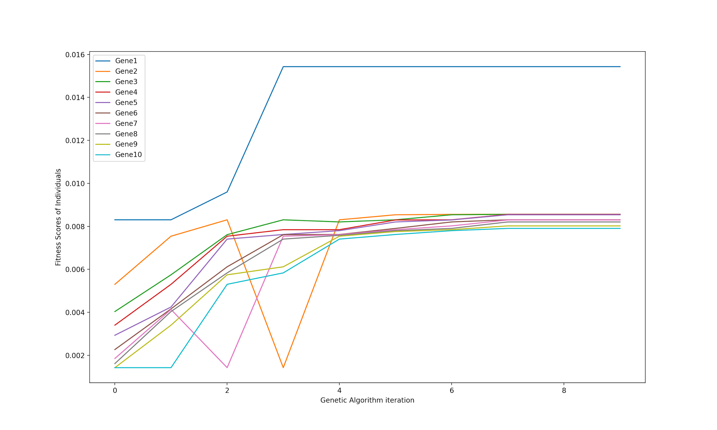
Results # 3
Convergence
Fitness Function parameters:
Max Degree
Cost (Network weight)
Time Delay
Tolerance
(Min-cut edge)

Slide 18
Our Progress
We put forth a pseudorandom approach using a GA-based method to address the optimization problem within the large-scale networks
Simulation results show that our approach is an efficient and effective method for solving the aforementioned problem

Slide 19
Future Work
Comparison of our algorithm with other methods in terms of quality and time-complexity
Perform more comprehensive tests to understand the impact of GA parameters in scaling larger network problems
Extending the applications of this approach to other challenging areas within the cloud domain

Slide 20
Related Works

Slide 21
Gong, Xu, et al. "An efficient genetic algorithm for large-scale planning of dense and robust industrial wireless networks." (2018)
Fadil, Yousra Ahmed. "Routing using genetic algorithm for large networks." (2010)
Dengiz, Berna, Fulya Altiparmak, and Alice E. Smith. "Genetic algorithm design of networks considering all-terminal reliability." (1997)
Singla, Ankit, et al. "Jellyfish: Networking data centers randomly." (2012)

Slide 22
Reproducibility Instructions

Slide 23

THANK YOU!

